Slide 1
Tailwind CSS Essentials for Developers
Kevin Griffin
kevin@consultwithgriff.com | consultwithgriff.com
twitter.com/1kevgriff

Slide 2
Let’s start with some code

Slide 3

Hey there!
Kevin Griffin
12x Microsoft MVP
ASP.NET Core, Azure, and Web
consultwithgriff.com
twitter.com/1kevgriff
twitch.tv/1kevgriff

Slide 4
If CSS has an API…

Slide 5
Installation and Setup
Skipping this as a convenience
https://tailwindcss.com/docs/installation for all the information

Slide 6

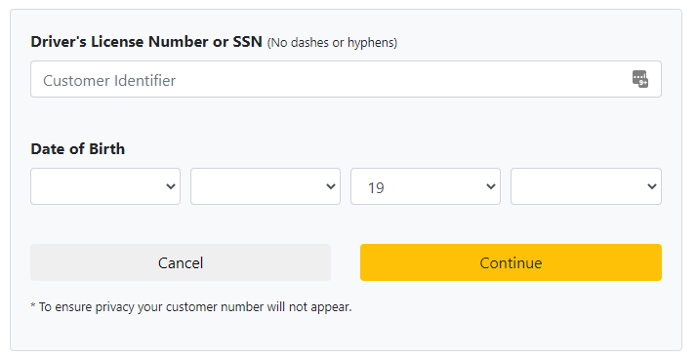
We don’t talk about Bootstrap…
First, Bootstrap is still an okay solution
But all Bootstrap sites look the same

Slide 7
We don’t talk about Bootstrap…
Bootstrap (and Bootstrap templates) don’t give you much flexibility without overhauling CSS
A lot of components require JavaScript to work appropriately.

Slide 8
We don’t talk about Bootstrap…
Let’s not judge Tailwind CSS and Bootstrap as equals – they are not.

Slide 9
We have a lot to cover!
Layout
Sizing
Colors
Typography
Variants
Responsive Design
Performance / Deployment
Frameworks Support
Extras?

Slide 10
I’m glossing over A LOT of material
https://tailwindcss.com/docs

Slide 11
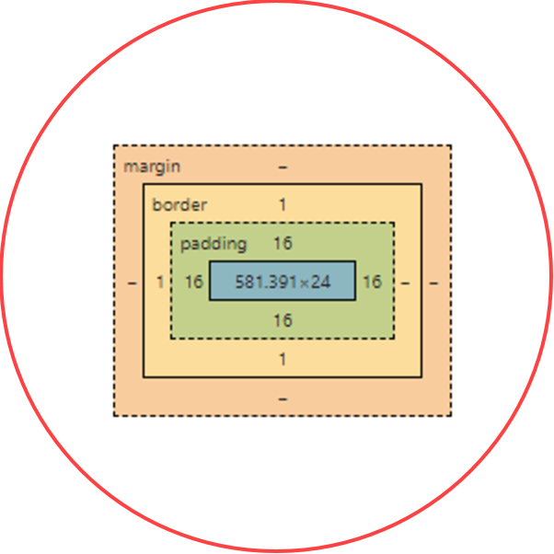
Layout
The Box Model

Slide 12
Box Model Helpers
<div></div>

Slide 13
Box Model Helpers
<div class=“p-5”>
</div>

Slide 14
Box Model Helpers
<div class=“pt-5”>
</div>

Slide 15
Box Model Helpers
<div class=“pb-5”>
</div>

Slide 16
Box Model Helpers
<div class=“pl-5”>
</div>
<div class=“pr-5”>
</div>

Slide 17
Box Model Helpers
<div class=“px-5”>
</div>

Slide 18
Box Model Helpers
<div class=“py-5”>
</div>

Slide 19
Box Model Helpers
<div class=“m-5”>
</div>

Slide 20
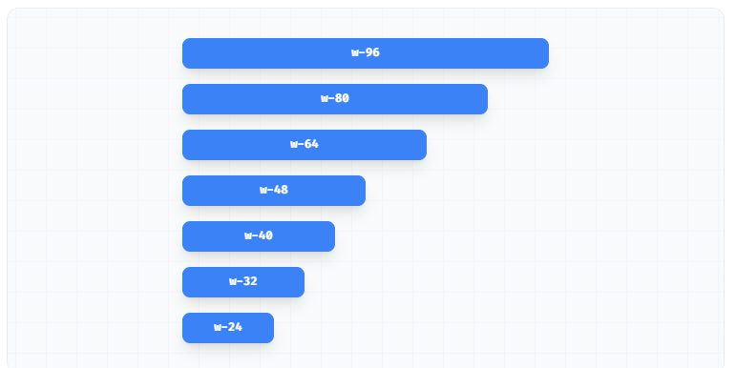
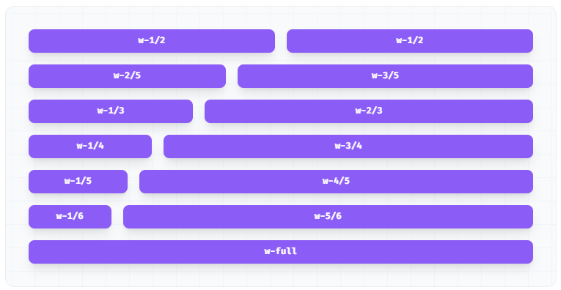
Widths

Slide 21
Let’s dive into some examples!

Slide 22
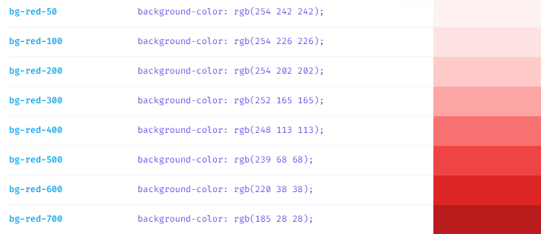
Colors

Slide 23
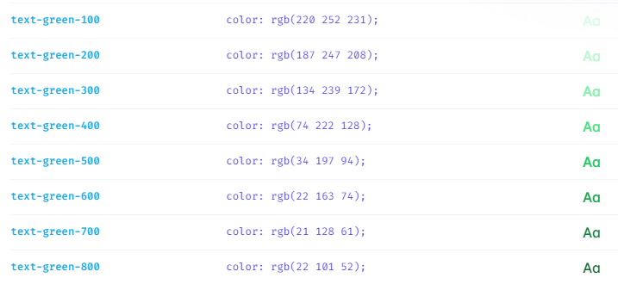
Colors

Slide 24
Custom attributes

Slide 25
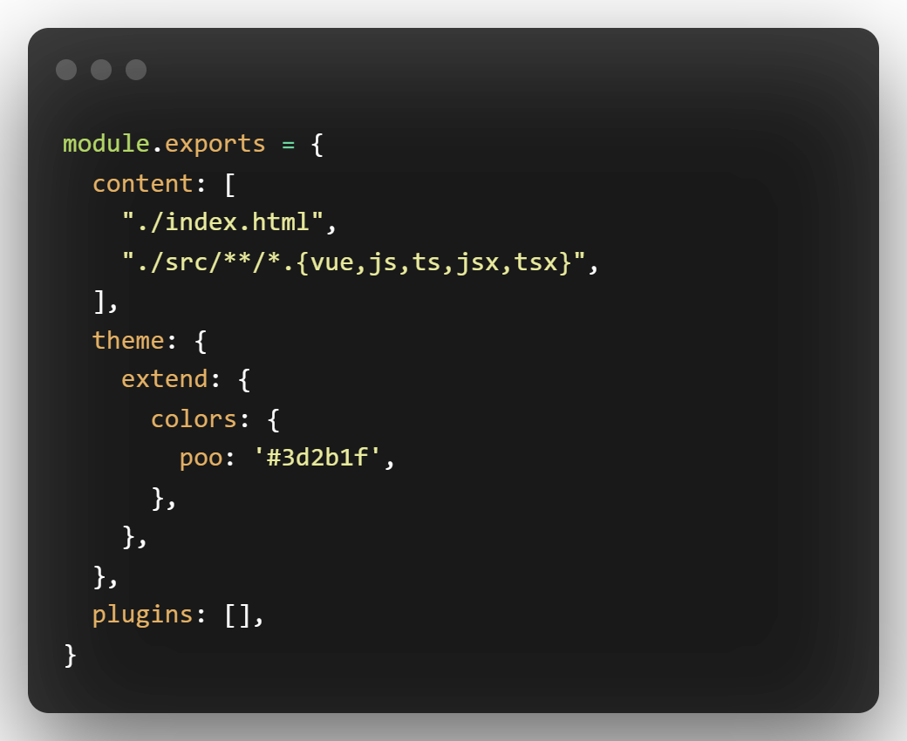
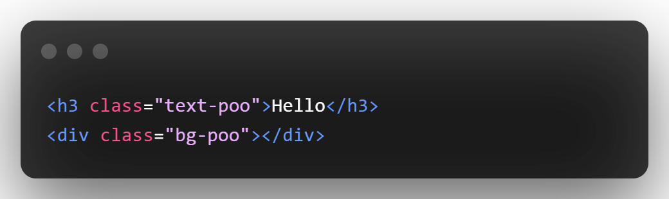
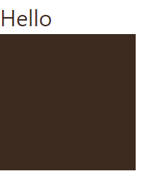
Custom Attributes

Slide 26
Variants

Slide 27
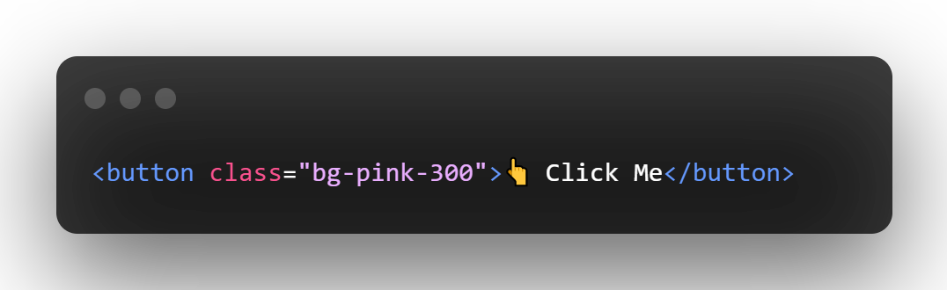

Variants (hover, active, disabled)

Slide 28
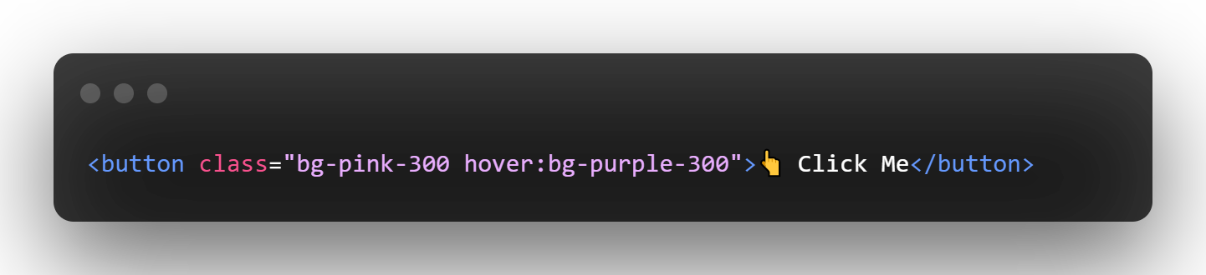

Variants (hover, active, disabled)

Slide 29
Speed Round
Let’s design some buttons

Slide 30
Custom Components
Or “that button CSS is very verbose”

Slide 31
Responsive Design

Slide 32
Performance and Deployment

Slide 33
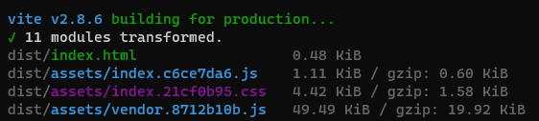
Performance and Deployment
Tailwind is designed to be a part of a build system
This include automatic tree shaking – no unnecessary CSS
The build grows only when you use more!

Slide 34
Framework Support

Slide 35
Thanks for coming!
Kevin Griffin
12x Microsoft MVP
ASP.NET Core, Azure, and Web
consultwithgriff.com
twitter.com/1kevgriff
twitch.tv/1kevgriff

